Slide 1

Internet of Things (IoT)
By Narayan Vyas
Head of IoT Department, SmartMade Infotech
Founder and CEO, Web Dev Fusion

Slide 2
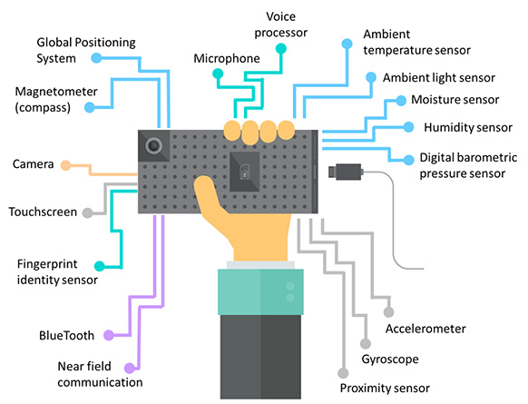

Slide 3

GitHub Repositories Link
https://github.com/narayanvyas/IoT-Workshop/

Slide 4

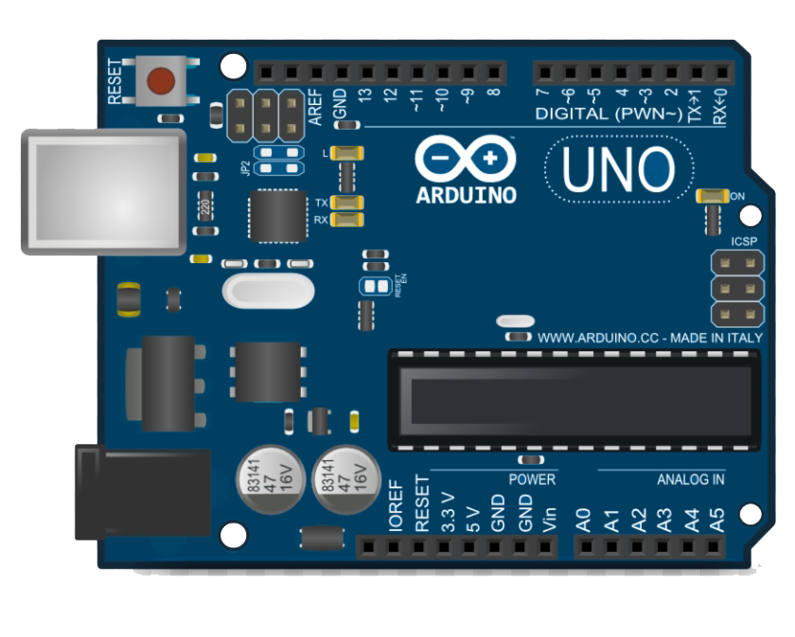
Arduino is an open hardware development board that can be used by tinkerers, hobbyists, and makers to design and build devices that interact with the real world.

Slide 5
History of Arduino
In 2005, building upon the work of Hernando Barragán (creator of Wiring), Massimo Banzi and David Cuartielles created Arduino, an easy-to-use programmable device for interactive art design projects, at the Interaction Design Institute Ivrea in Ivrea, Italy.

Slide 6
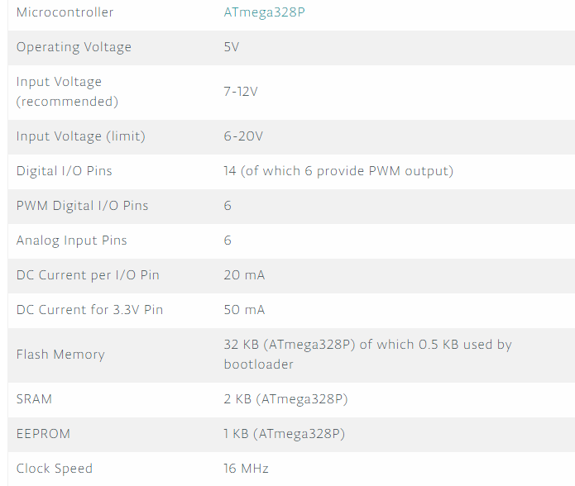
Features of Arduino

Slide 7
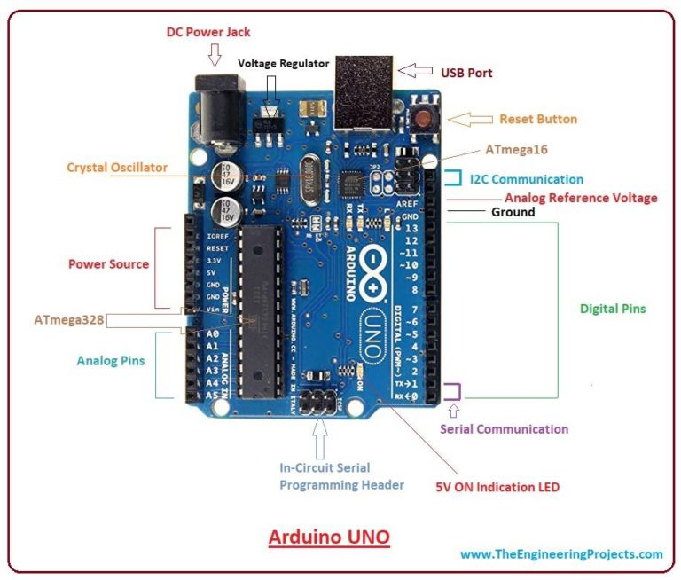

Slide 8
Protocols used in Arduino

Slide 9
Serial Communication
Serial communication is used to exchange data between the Arduino board and another serial device such as computers, displays, sensors and more.
Each Arduino board has at least one serial port. Serial communication occurs on digital pins 0 (RX) and 1 (TX) as well as via USB.

Slide 10
SPI (Serial Peripheral Interface )
SPI is a serial data protocol used by microcontrollers to communicate with one or more external devices in a bus like connection. The SPI can also be used to connect 2 microcontrollers.
On the SPI bus, there is always one device that is denoted as a Master device and all the rest as Slaves. The SS (Slave Select) pin determines which device the Master is currently communicating with.
SS/SCK/MISO/MOSI pins are the dedicated pins for SPI communication. They can be found on digital pins 10-13 of the Arduino Uno and on the ICSP headers.

Slide 11
I2C
I2C is a communication protocol commonly referred to as the “I2C bus”. The I2C protocol was designed to enable communication between components on a single circuit board.
With I2C there are 2 wires referred to as SCL and SDA. SCL is the clock line which is designed to synchronize data transfers. SDA is the line used to transmit data.
Each device on the I2C bus has a unique address, up to 255 devices can be connected on the same bus. SCL/SDA pins are the dedicated pins for I2C communication. On the Arduino Uno they are found on Analog pins A4 and A5.

Slide 12
ICSP Headers
ICSP stands for In-Circuit Serial Programming. The name originated from In-System Programming headers (ISP). Manufacturers like Atmel who work with Arduino have developed their own in-circuit serial programming headers.
These pins enable the user to program the Arduino boards’ firmware. There are six ICSP pins available on the Arduino board that can be hooked to a programmer device via a programming cable.

Slide 13

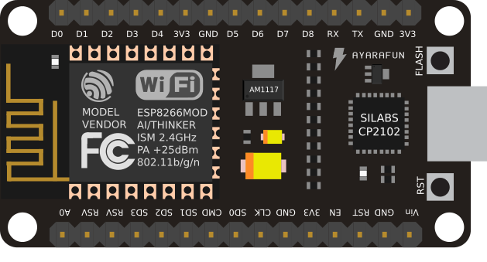
NodeMCU is an open source IoT platform. It includes firmware which runs on the ESP8266 Wi-Fi SoC from Espressif Systems, and hardware which is based on the ESP-12 module.

Slide 14
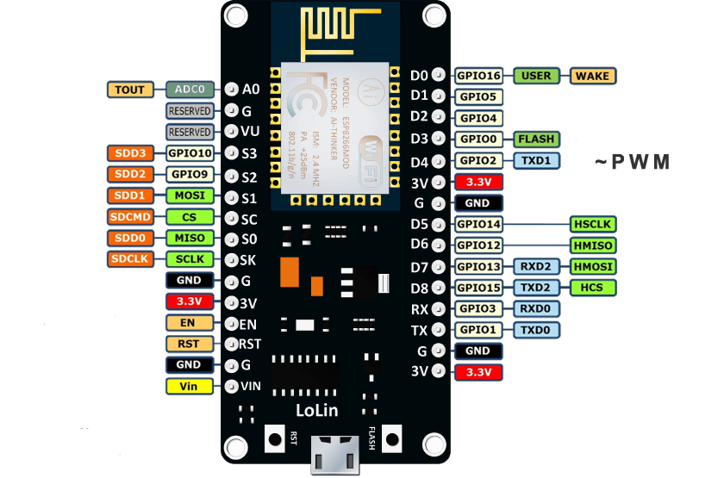

Slide 15
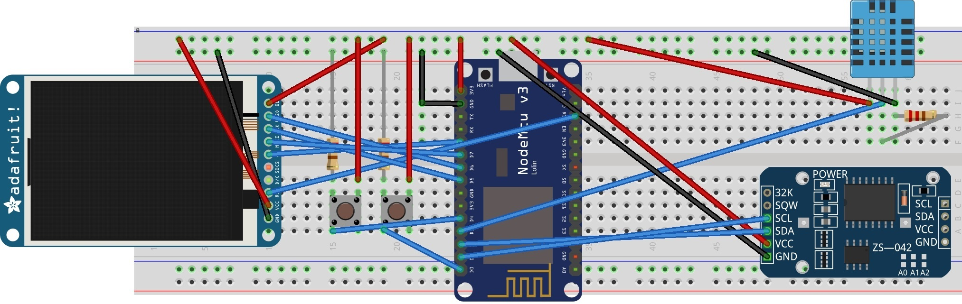
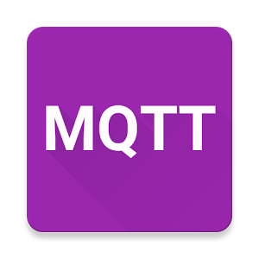
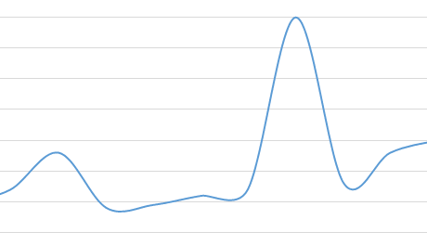
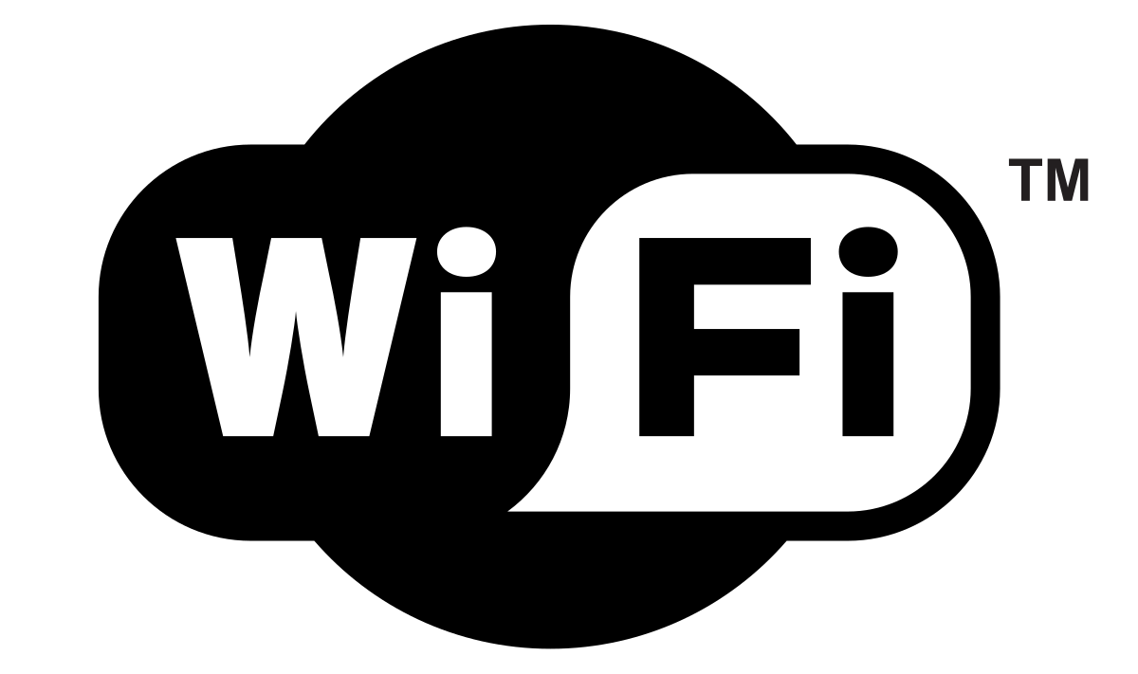
Weather Station

Slide 16


Slide 17

Thank You
www.smartmade.in
www.webdevfusion.com
www.narayanvyas.org

